Slide 1

From lab to patient
How statistics shapes decisions in medicine
Nicola Rennie
Royal Statistical Society William Guy Lecturer 2024 - 2025

Slide 2

About Me
Text goes here

Slide 3
Some of the things I do
Text goes here

Slide 4
Today
Text goes here

Slide 5
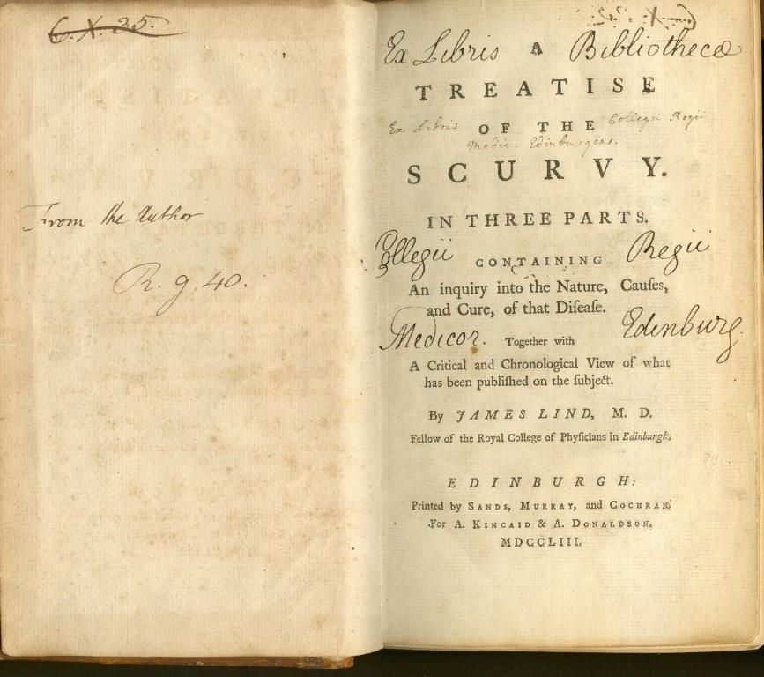
One of my favourite examples of a clinical trial goes all the way back to 1747. At that time, a disease called scurvy was a huge problem for sailors. Scurvy is caused by not having enough vitamin C - although in 1747, we didn’t know that. James Lind, a Scottish doctor in the Royal Navy, selected 12 patients with scurvy on a ship, and gave them each one of 6 possible treatments. Some of the treatments included drinking vinegar, eating garlic paste, drinking sea-water, or eating citrus fruits like lemons or oranges. The sailors whose daily diet included citrus fruits recovered, but the others still had symptoms - showing that citrus fruits could cure scurvy.

Slide 6
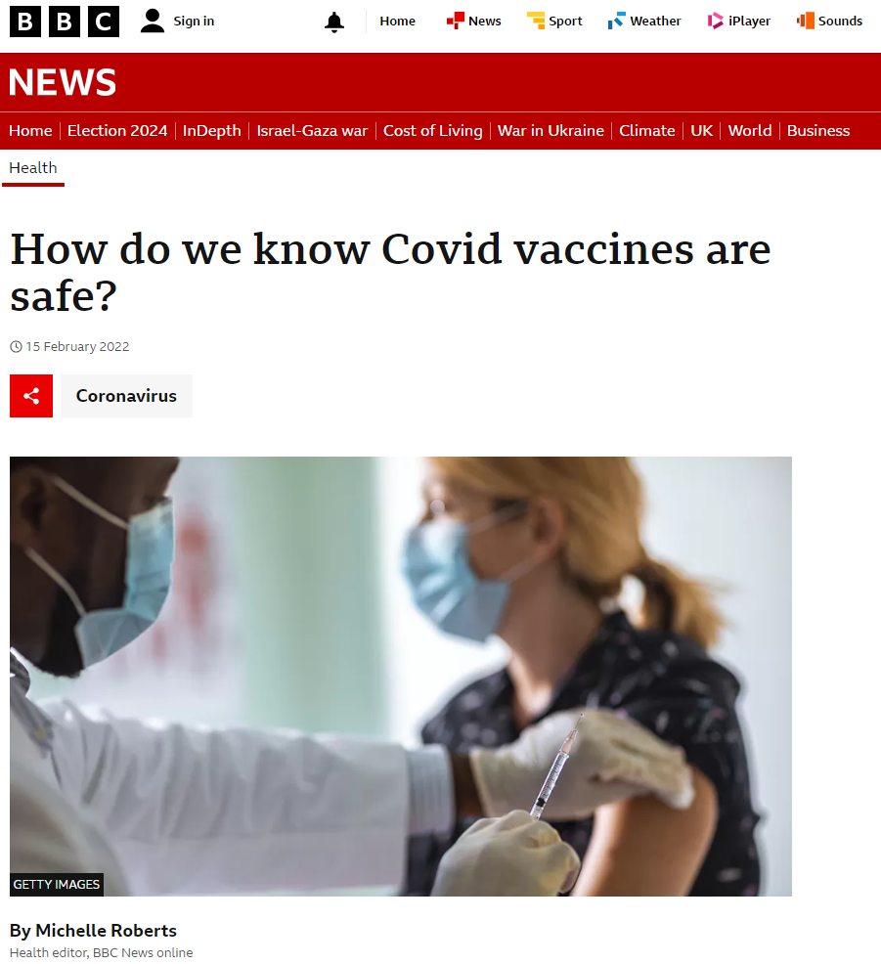
One of my favourite examples of a clinical trial goes all the way back to 1747. At that time, a disease called scurvy was a huge problem for sailors. Scurvy is caused by not having enough vitamin C - although in 1747, we didn’t know that. James Lind, a Scottish doctor in the Royal Navy, selected 12 patients with scurvy on a ship, and gave them each one of 6 possible treatments. Some of the treatments included drinking vinegar, eating garlic paste, drinking sea-water, or eating citrus fruits like lemons or oranges. The sailors whose daily diet included citrus fruits recovered, but the others still had symptoms - showing that citrus fruits could cure scurvy.

Slide 7
Example
Text goes here

Slide 8
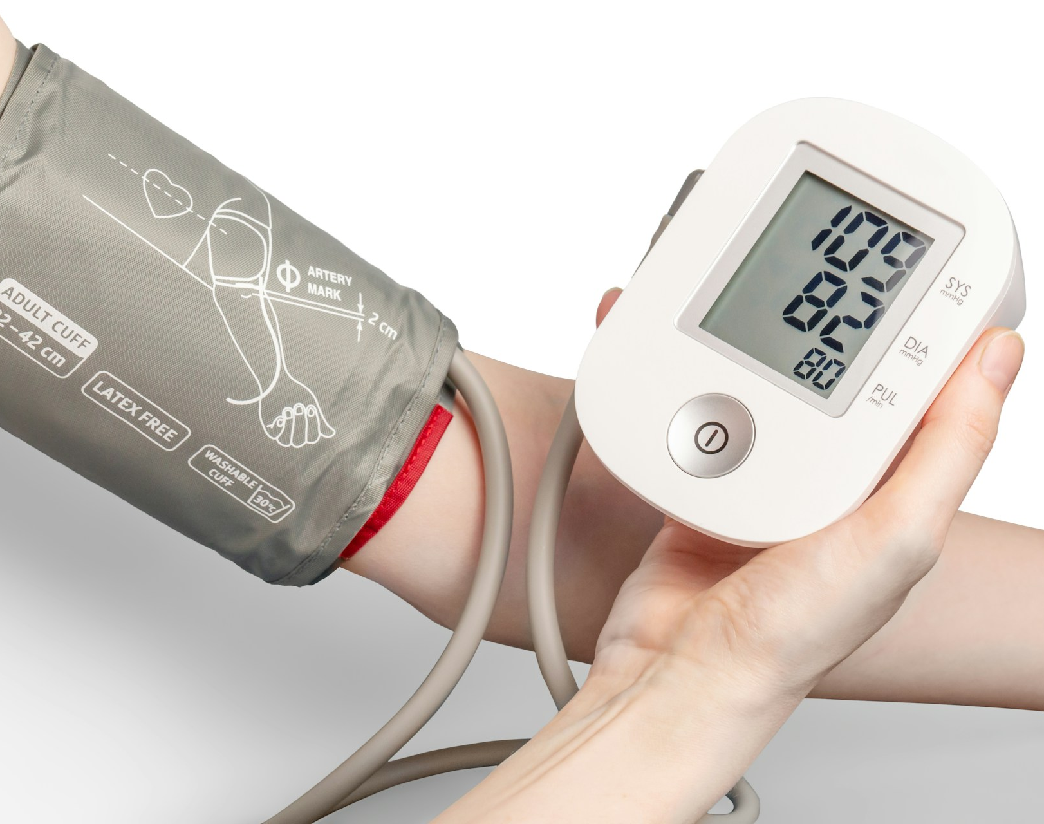

Slide 9
How do we decide who gets which treatment?

Slide 10
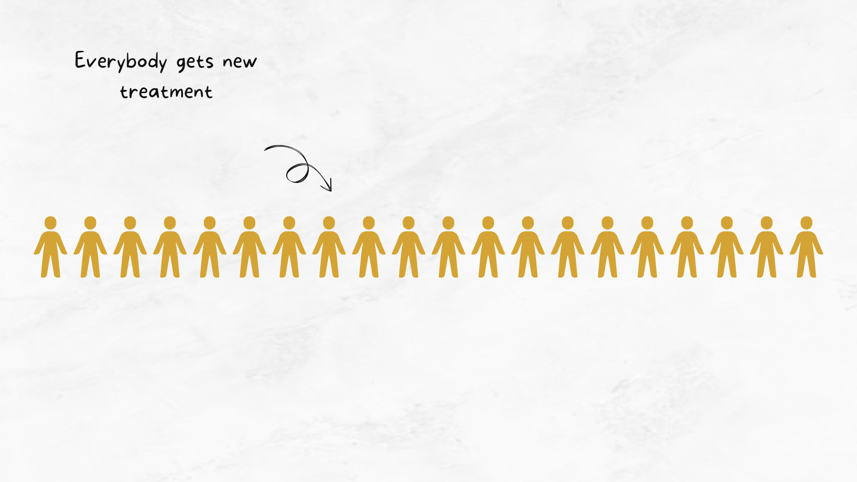

Slide 11
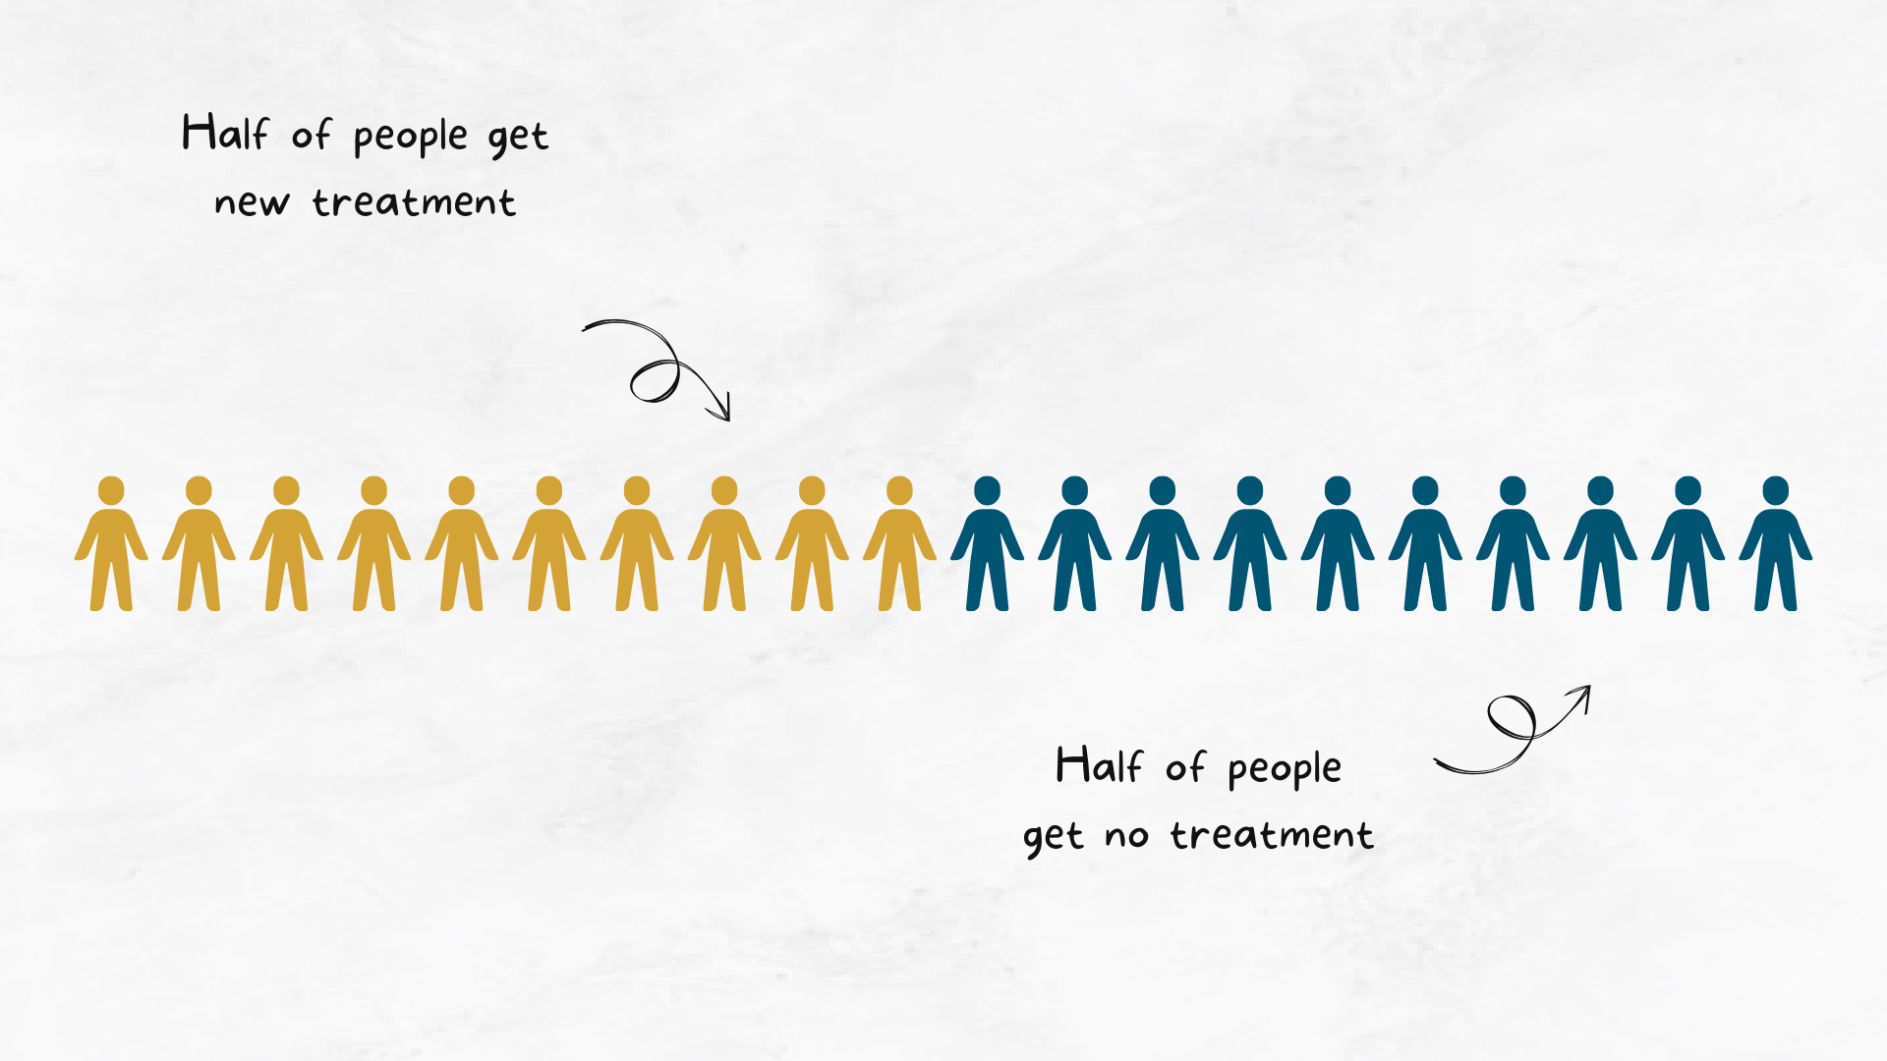

Slide 12


Slide 13
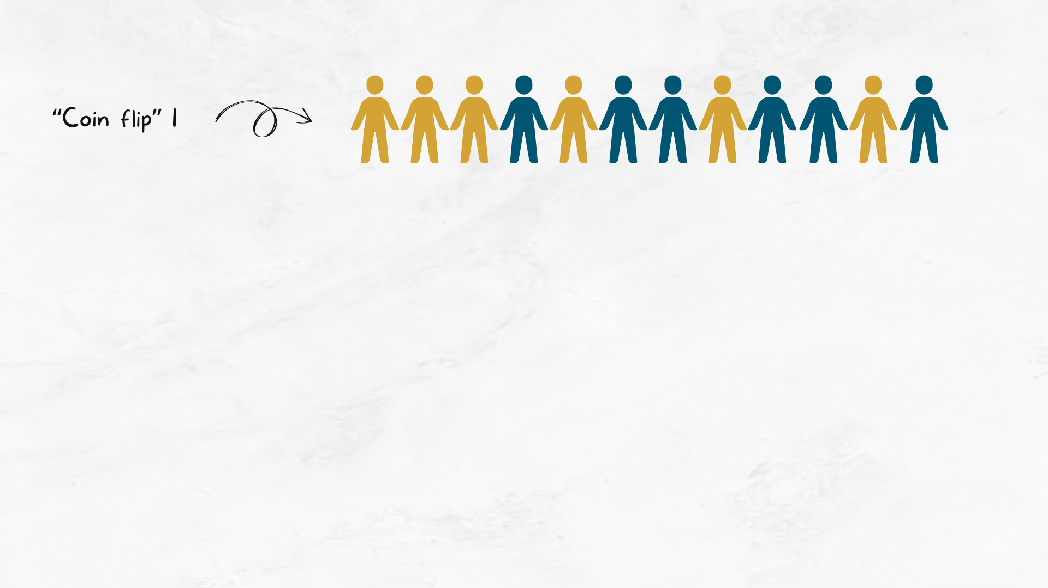

Slide 14
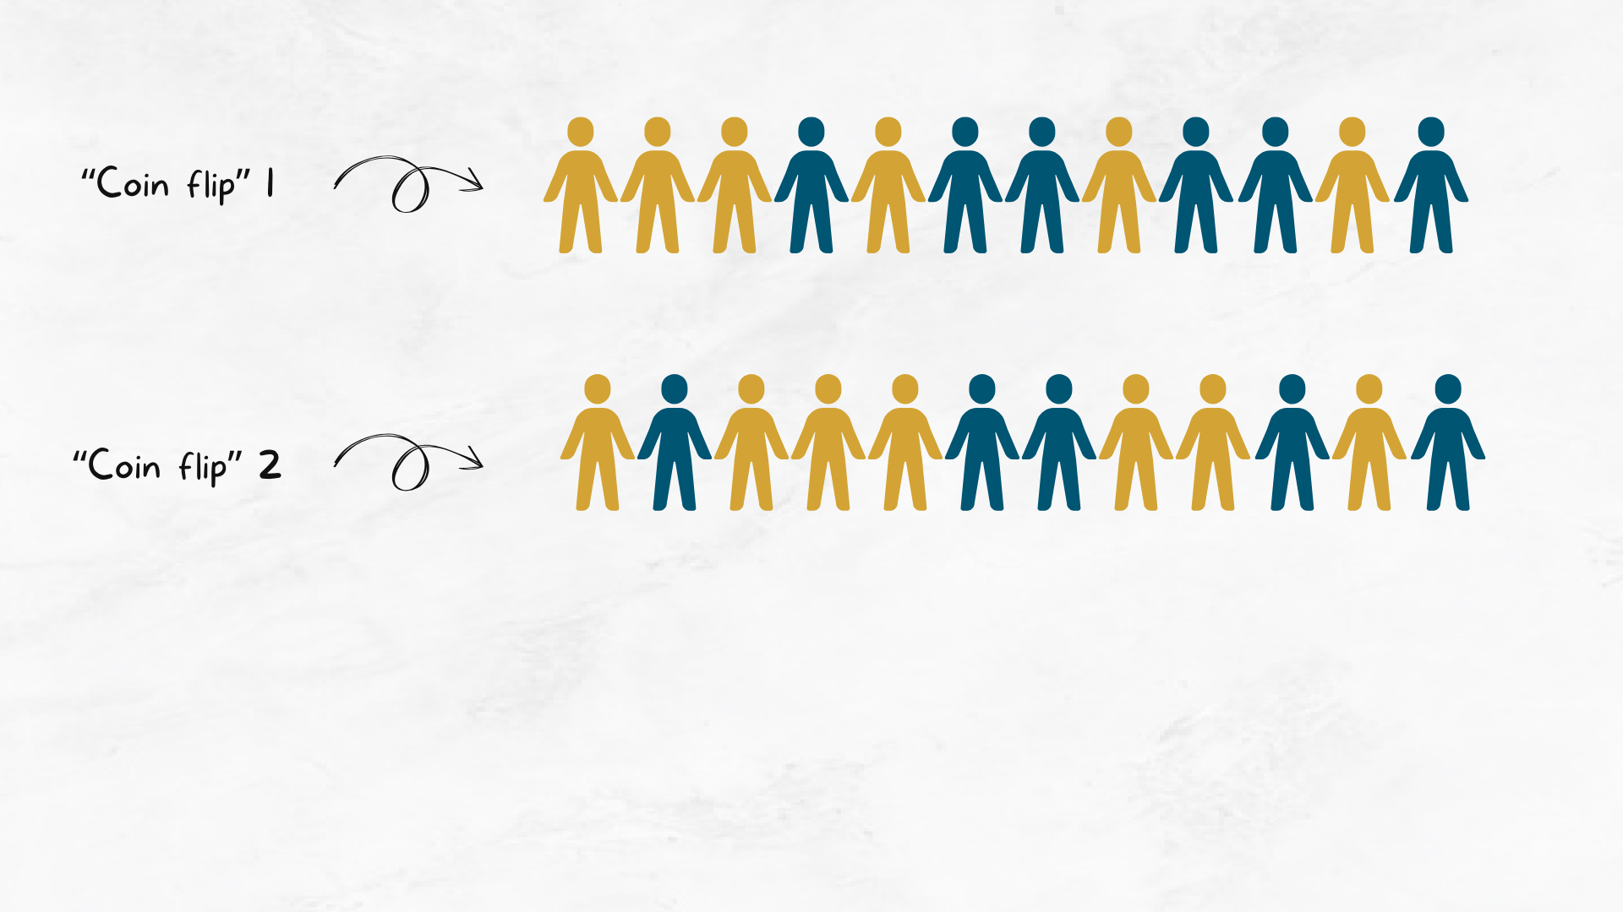

Slide 15
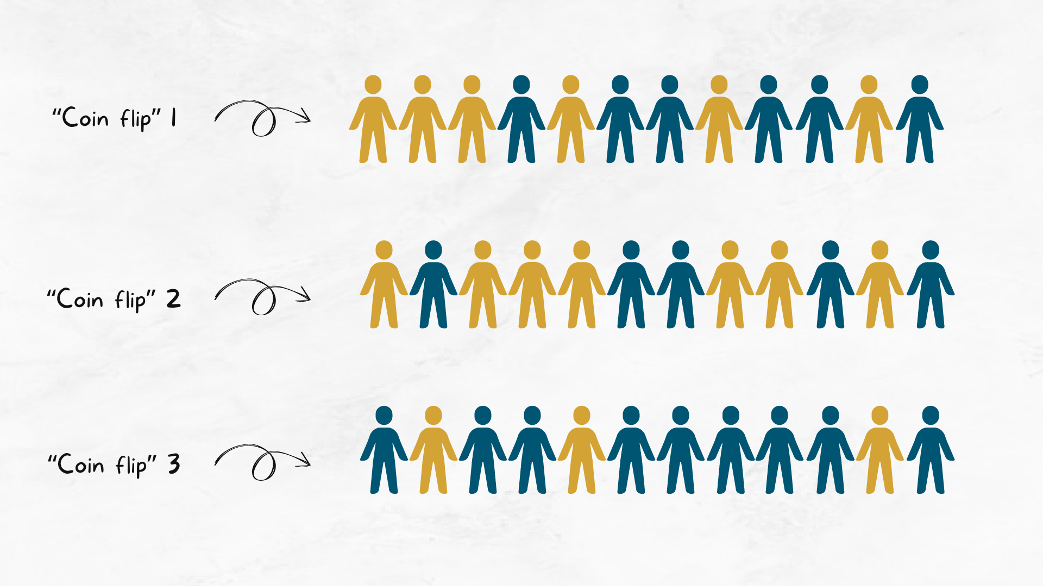

Slide 16
How do we know if a treatment works?

Slide 17
What do we measure?
Text goes here

Slide 18
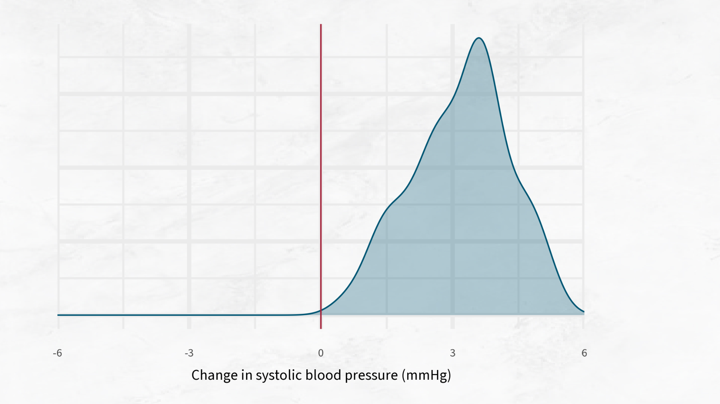

Slide 19
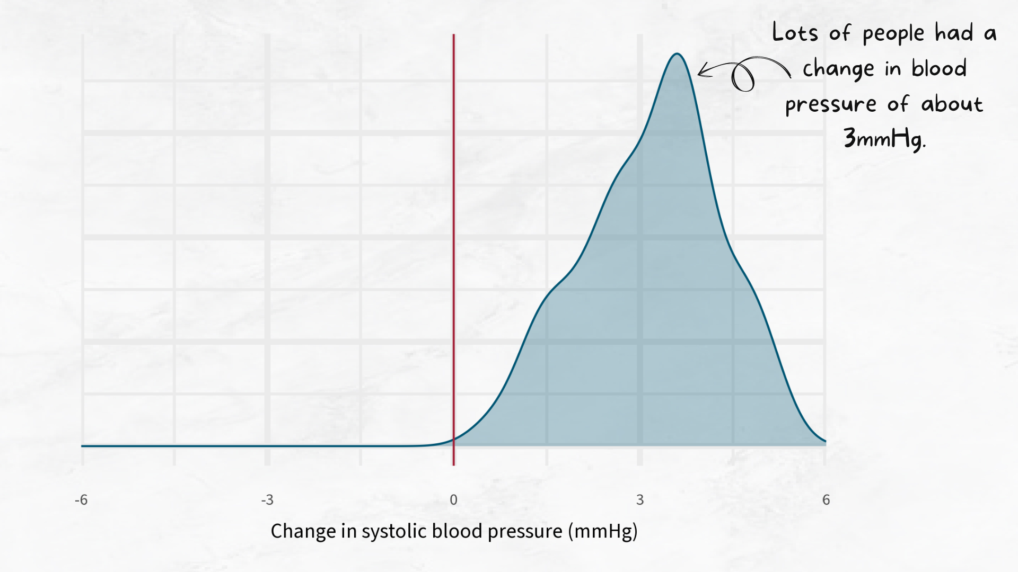

Slide 20
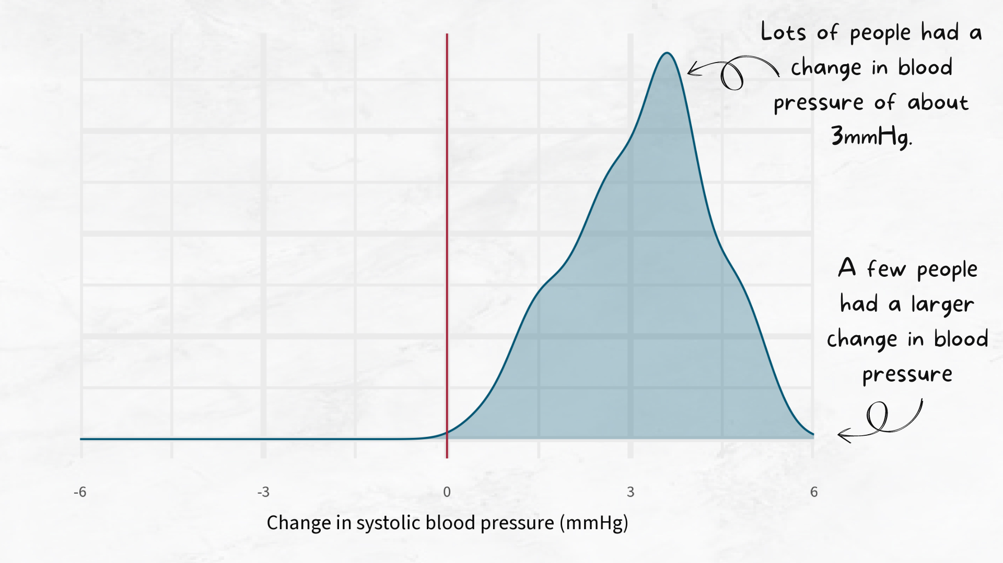

Slide 21
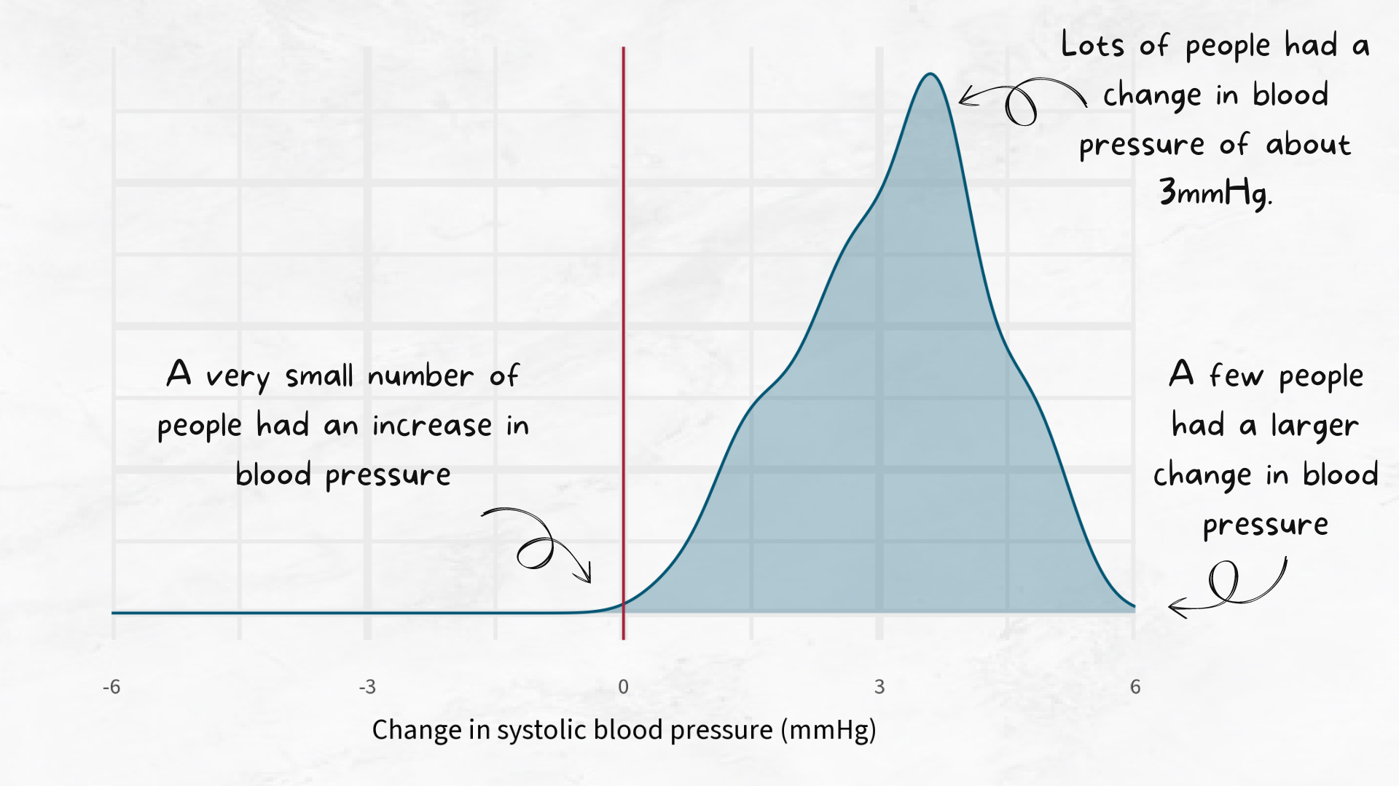

Slide 22
How many people do we need?
Text goes here

Slide 23
How do we compare two treatments?

Slide 24
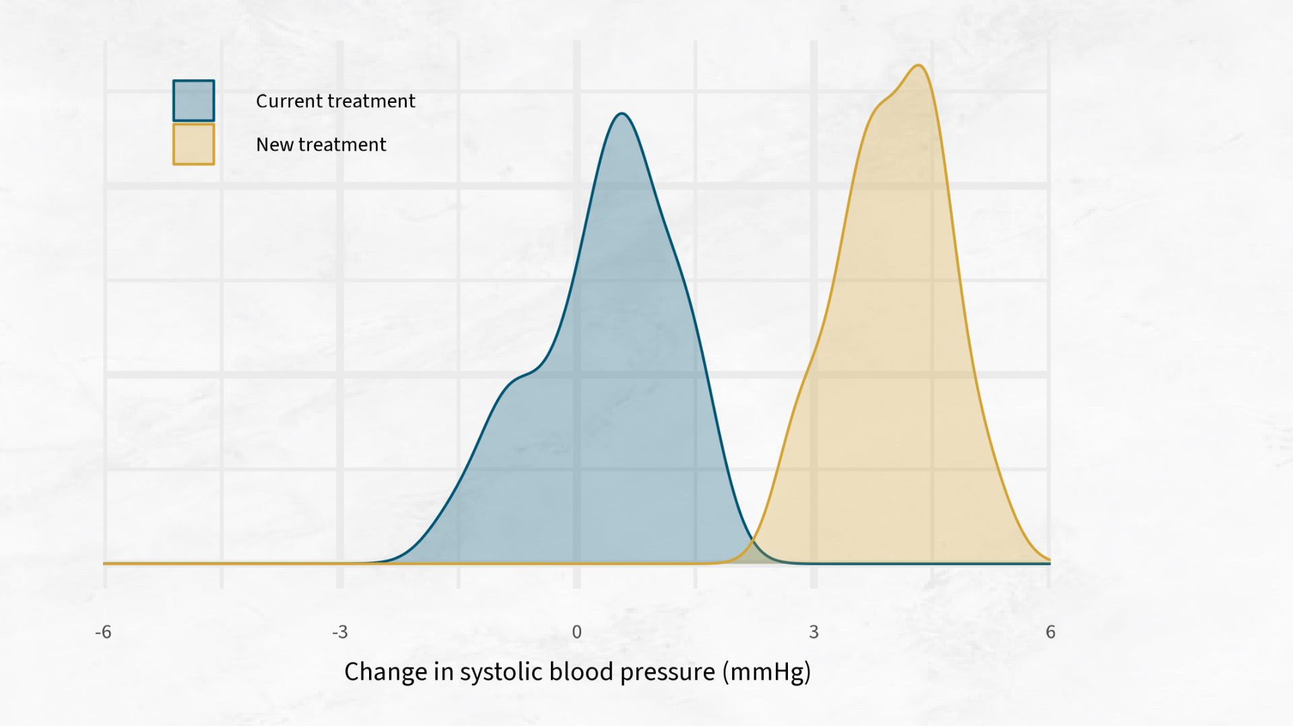

Slide 25
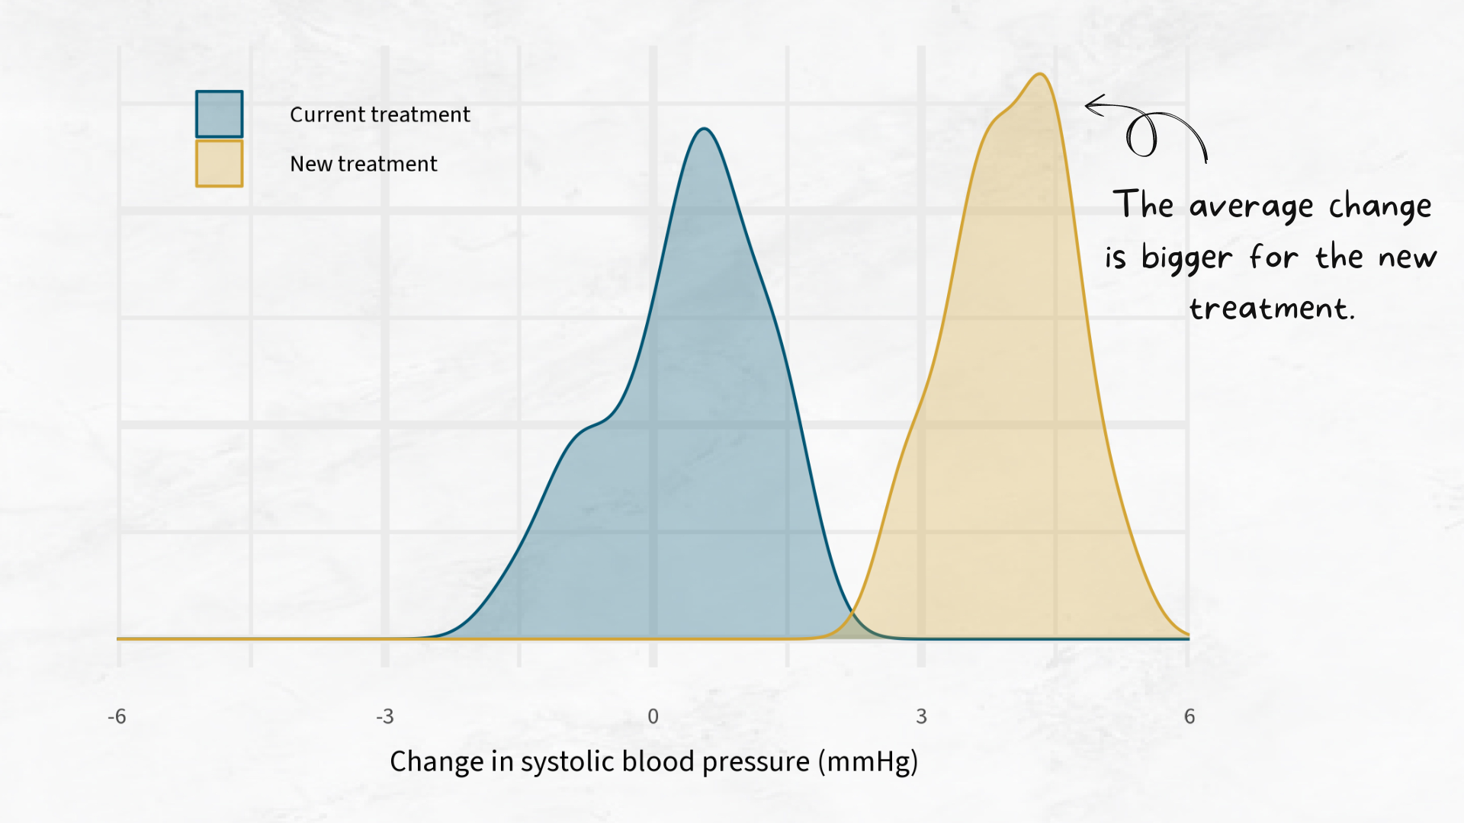

Slide 26
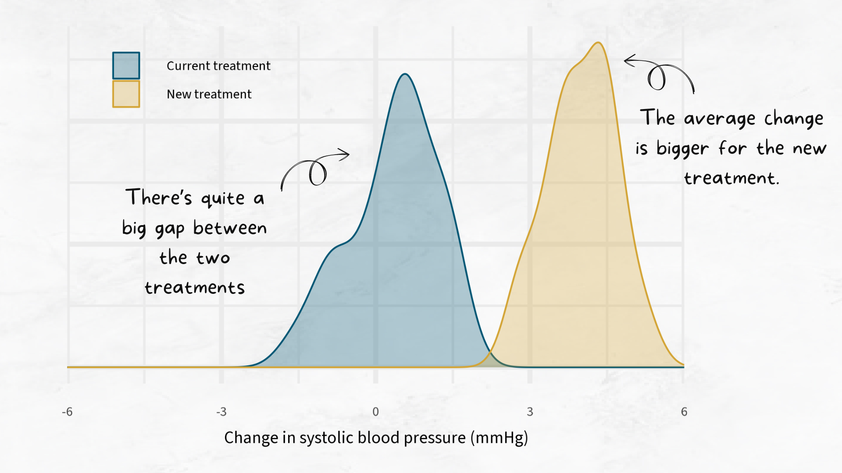

Slide 27
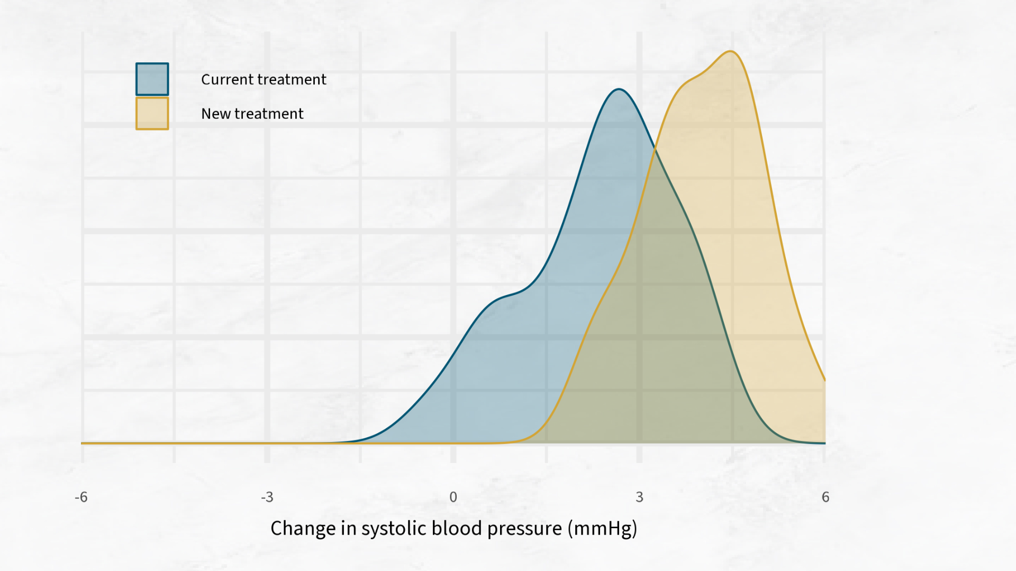

Slide 28
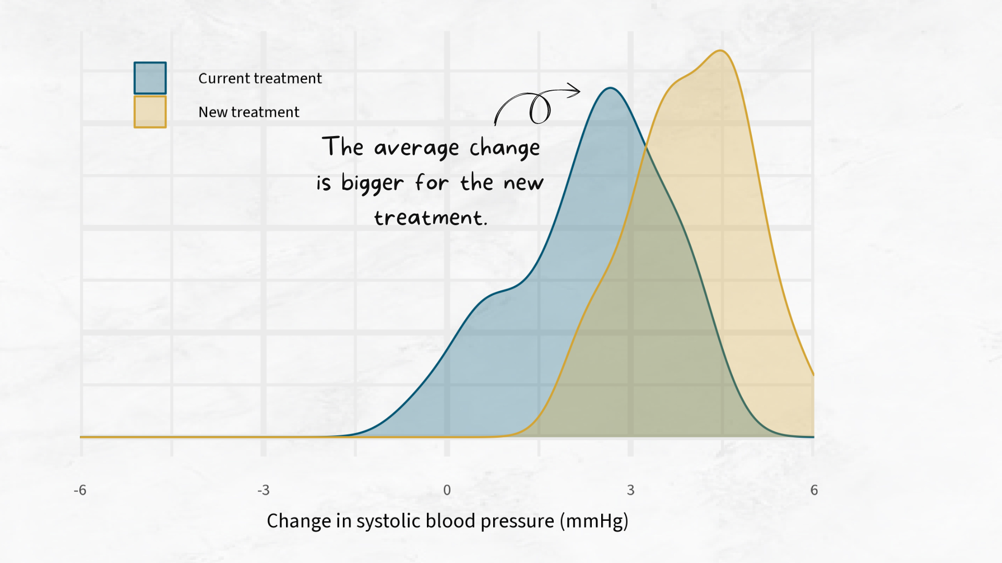

Slide 29
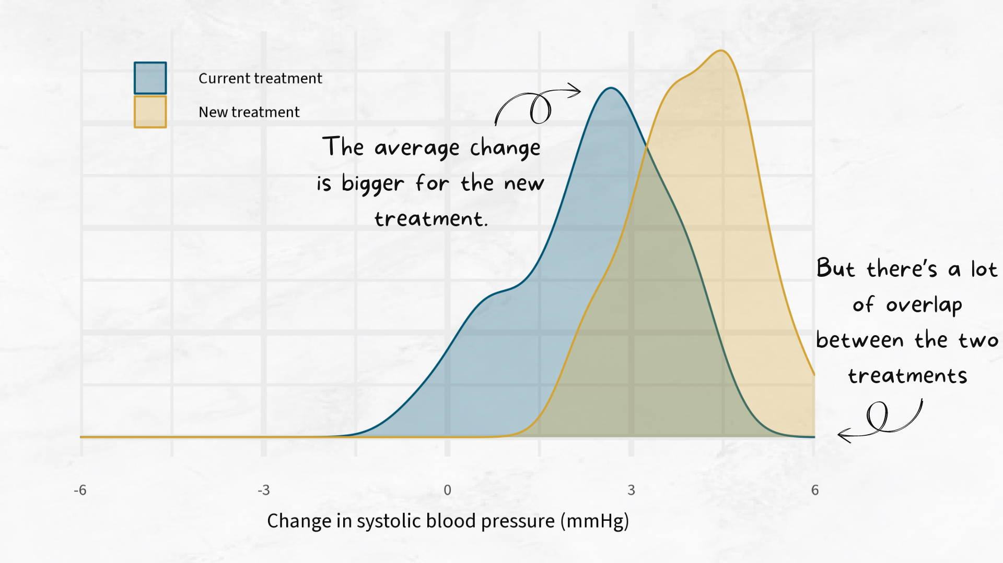

Slide 30
Summary
Text goes here

Slide 31
Questions?
Nicola Rennie
Royal Statistical Society William Guy Lecturer 2024 - 2025

